Slide 1
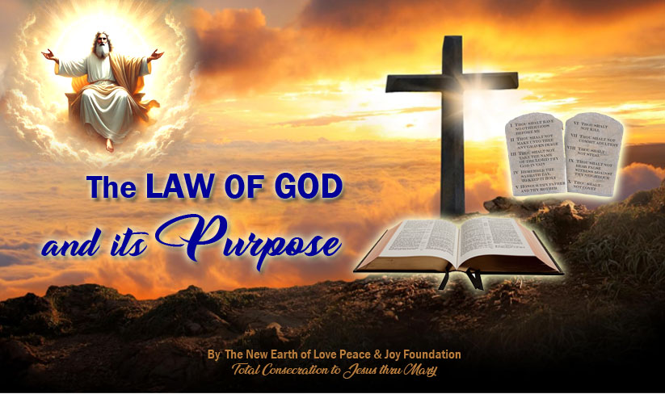

Slide 2

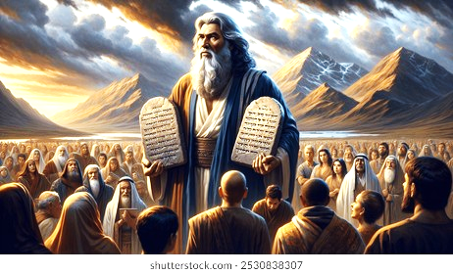
Understanding the purpose of the Law of God is very important for us who would like to follow Jesus through Mary. God the Father has given us the 10 Commandments, and we must take them seriously since God is God and each one of us is nothing without Him.
Psalm 119 was the inspiration for this talk. Before we begin, let’s all stand up and praise God’s Law by reciting the first part of Psalm 119.

Slide 3
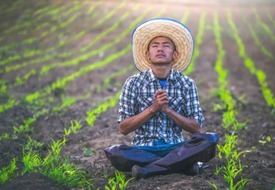
PSALM 119
Praise of God’s Law
¹Blessed are they whose ways are blameless,
who walk in the law of the Lord.
²Blessed are they who keep His commands, who seek Him with all their heart,
³And do no wrong, but walk in His ways.
⁴You have commanded that Your laws be diligently kept.
⁵Oh, that I might be firm in the ways of keeping Your laws!
⁶Then I shall not be put to shame, having my eyes fixed on all Your commandments.
⁷I will praise You with an upright heart, as I learn Your just orders.
⁸I will keep Your commands, do not abandon me completely.

Slide 4
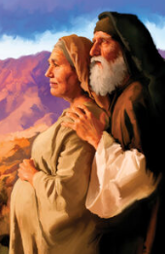
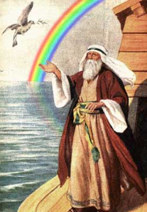
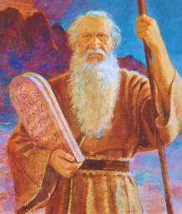
God established covenants with us, first through Abraham, then through Noah, then through Moses to whom God gave us the 10 Commandments.
The Law of God begins with the 10 Commandments. It is the basis of our covenant with God. A covenant is a sacred and binding agreement and relationship between God and persons. It brings blessings when obeyed and punishment when disobeyed.
For example, in the Old Testament, God punished the Israelites because of disobedience.

Slide 5
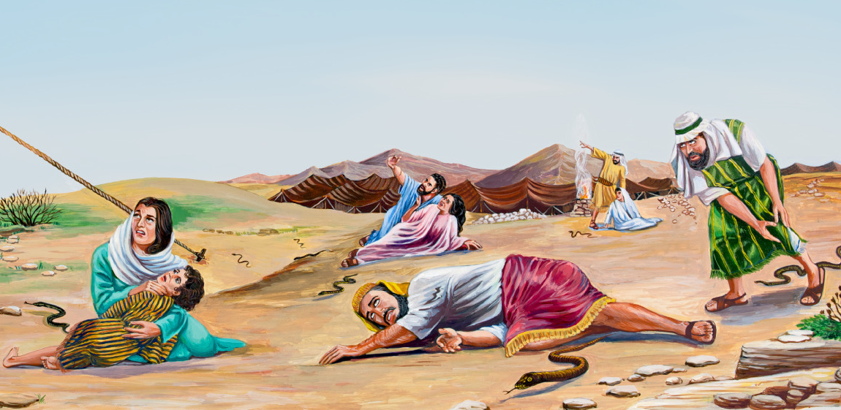
Moses, the Disobedient Jews and the Bronze Serpent
Numbers 21: 4-9
“…the people grew impatient on the way; and the people complained against God and against Moses, "Why have you brought us up out of Egypt to die in this desert, where there is no food or water? We are disgusted with this worthless food!" In punishment the Lord sent poisonous serpents among the people, and they bit the people
and many Israelites died.
Then the people came to
Moses and said, "We have
sinned, for we spoke against
the Lord and against you.

Slide 6
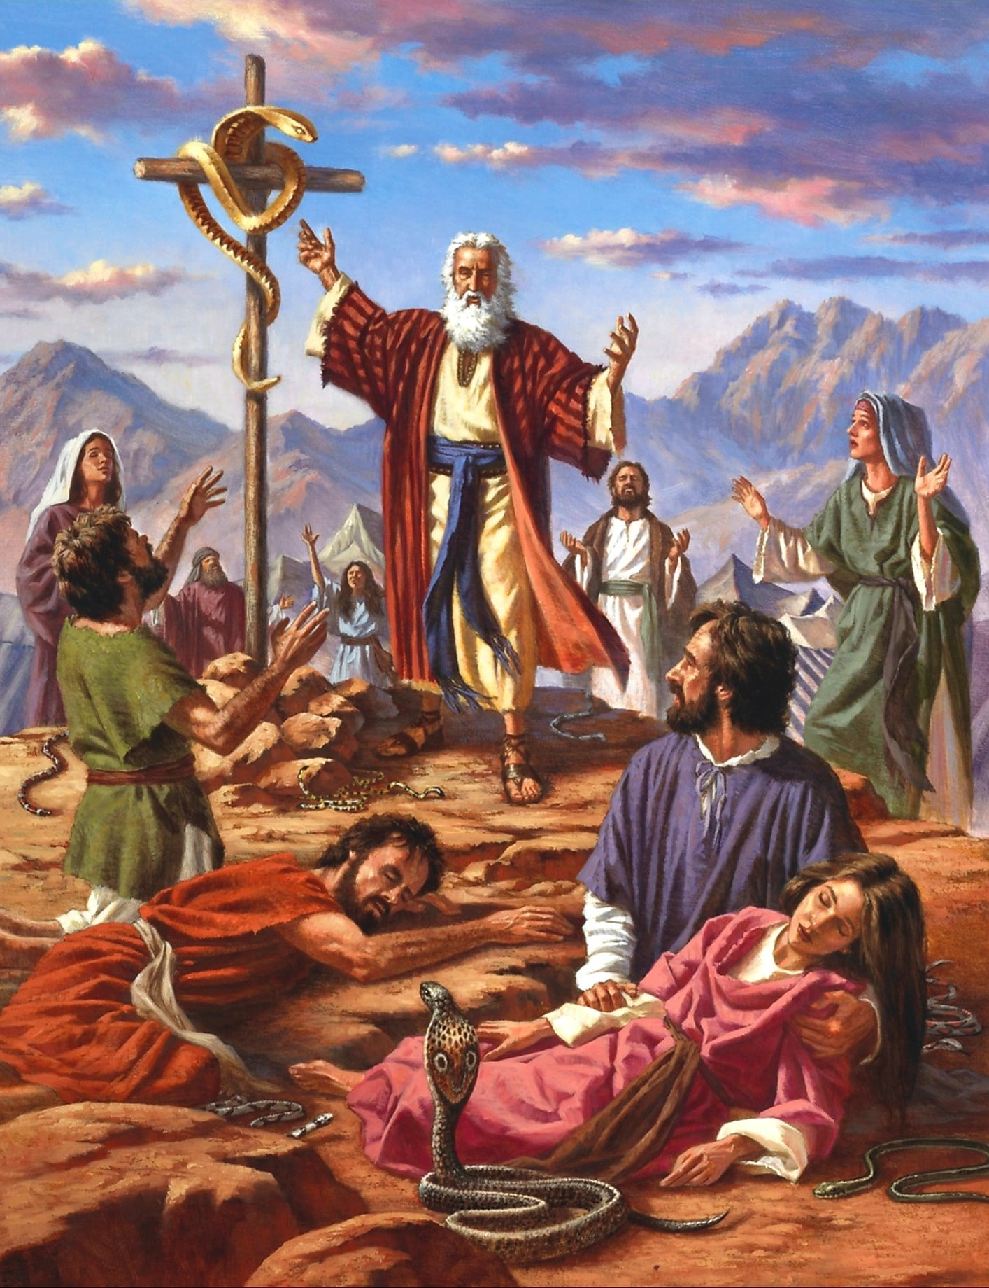
Pray to the Lord that He will take the serpents from us."
So, Moses prayed for the people.
And the Lord said to Moses, "Make a fiery serpent and set it on a pole, and if anyone who has been bitten looks at it, he will recover and live." Moses accordingly made a bronze serpent and set it on a pole, and if a serpent bit any man, he would look at the bronze serpent, he recovered and lived.”

Slide 7

Today, many people do not obey the covenant and the laws given by God. God is faithful, but the people are not. Many times we commit to serve God, especially when we are in trouble. We say, “Yes Lord, I will serve you!” But after some time, we get busy with other things and fail to keep our commitments to God.

Slide 8
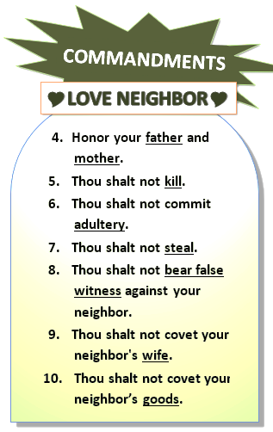
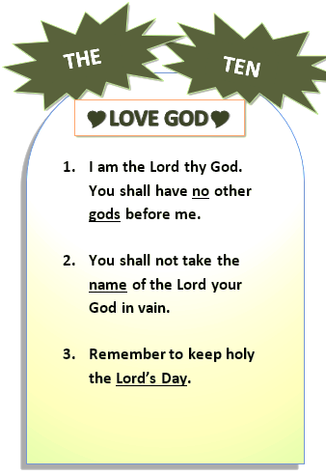
In order to be faithful to God’s Laws, the 10 Commandments, we should understand the purpose why God gave these Commandments to us.
The first 3 Commandments
teach us how to love and
serve God.
The 7 last Commandments
teach us how to love and
serve others.
He gave the 10 Commandments
to us in order to govern us and
to teach us as a good and loving
Father.

Slide 9
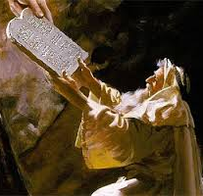
The following are 7 Biblical reasons why God gave us His Law:
1. To demonstrate God’s holiness and perfection-
God wrote the 10 Commandments with His own hand- in two tablets of stone- and gave them to Moses, for His Chosen People. We learn from this that there is One God the Father who is perfect and the source of holiness and righteousness. “Be perfect, therefore, as your heavenly Father is perfect.”- (Matthew 5:48). God’s perfections sets the standard of conduct that people have to follow so that they will know God and have an intimate relationship with Him.

Slide 10
For example, the 8th Commandment is: “You shall not bear false witness against your neighbors.” This commandment points out the character of God who wrote it. He is a God of truth and will never lie. This is an important commandment because each person, family, community and nation, which is based on dishonesty will collapse.
The 5th Commandment says, “You shall not steal.” That is why we have to pray for graft and corruption to end in our country. Where does that begin? It begins with me, and each one of you. We need to be honest and truthful in everything we say and do, even in little things.
Every disorder in our society, in our families, in ourselves,
can be traced back to disobedience to God’s commandments.

Slide 11
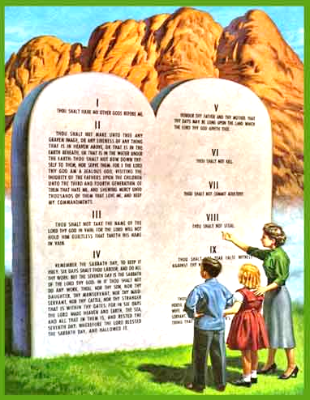
2. To help God’s people
become holy-
The 10 Commandments were given by God
not only to the Jews, but to all men, to all of us.
If you follow the 10 Commandments in your
life and in your work, you will become holy.
If you teach them by your example and words,
first to your family, and wherever you go to live, work and do apostolate, you become God’s instrument to bring about holiness in people. And without holiness, one cannot enter heaven.

Slide 12

3. To protect and provide for God’s people-
Remember always, that every
commandment, every Law that
God gave, are meant to protect
us and fill us with love, peace,
joy, protection and unlimited
blessings!
Consider every setback or trial
also as a blessing through which
God teaches us lessons or helps us gain virtues.

Slide 13
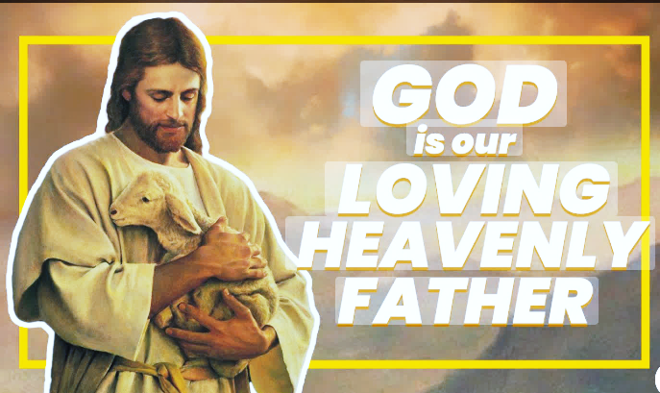
He gave commandments not
for the sake of controlling us
like a dictator, but like a loving
Father who wants to protect
us and bless us.
When we obey His commandments, God blesses us,
but when we disobey them, we suffer because God is a God of justice.

Slide 14
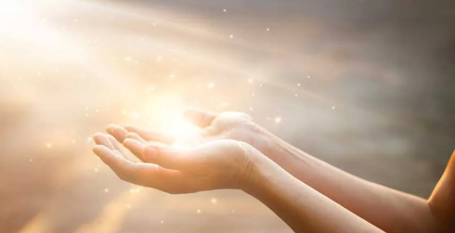
4. To show us that God gives us the
grace to do good works, and that we
should do them only out of Love for
Him.
To show us that God gives us the grace to do good works:
St. Paul tells us in Ephesians 2:10, ” ¹⁰For we are his workmanship, created in Christ Jesus in good works, which God has prepared beforehand that we may walk in them.”
This means that, through Jesus Christ, God gives us the grace to do good works, even before we start doing them. Therefore, we should do good works because God gives us all the graces to do them.

Slide 15
that we should do our good works only out of Love for God:
The 1st Commandment is: “I am the Lord Your God. You shall adore me alone and love me above all.”
WHY should you and I adore God alone and love Him above all?- because He first loved us. St. John tells us in 1 John 4:19: “¹⁹We love because he first loved us.”
HOW should you and I adore God alone and love Him above all? – by doing all our good works only out of love for Him. Love for God should be the only reason or motive for all our good works.

Slide 16
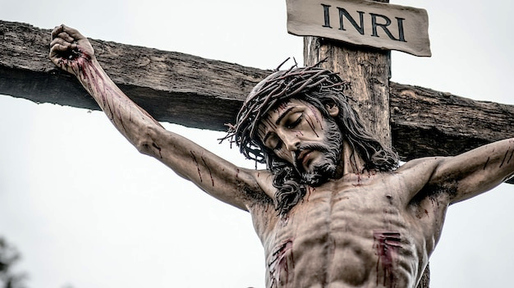
5. To show us how to imitate Jesus
and be like Jesus.
When we obey God’s laws and commandments,
we imitate Jesus who obeyed God the Father
even up to death on the cross.
This is how we imitate Jesus:
⁵Have this mind in you, which was also in Christ Jesus, ⁶who, though he was by nature God, did not consider being equal to God something to be attached to, ⁷but he emptied himself by taking the very nature of a slave and being born in the likeness of men. ⁸And appearing in the form of a man, he humbled himself, by becoming obedient to death, even to death on a cross. (Philippians 2:5-8)

Slide 17
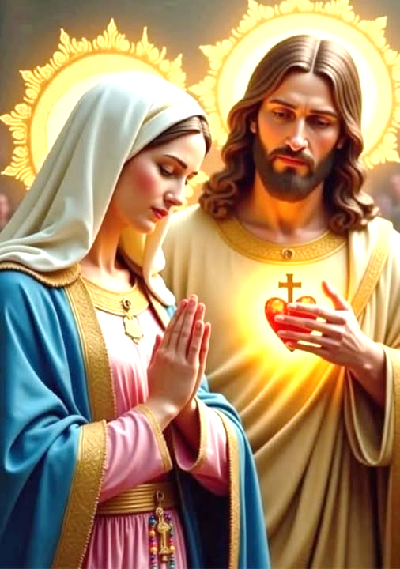
This is how we become like Jesus:
by praying TC JM daily and asking
Mama Mary to make us like her Son Jesus:
“Virgin most faithful, make me in everything
so committed a disciple, imitator, and slave
of Jesus, your Son, Incarnate Wisdom that I
may become, through your intercession and
example, fully mature with the fullness
which Jesus possessed on earth, and with
the fullness of His glory in heaven. Amen.”

Slide 18

6. To lead us to Jesus Christ-
²⁴So the Law has been our tutor to lead us to
Christ that we might be justified by faith.
²⁵But now that faith has come, we are no
longer under a tutor. (Galatians 3:24)
In Galatians 3:24, St. Paul tells us that the Law is a tutor or guardian that leads us to Christ. God’s final purpose for the Law is to lead us to Christ. The Law should make us practice humility and realize that we are helpless without Jesus. It should make us see the need for Jesus, our Redeemer, who fulfilled the Law and died in our place. It was the ultimate sacrifice of Jesus that paid for our sins and opened the gates of the heavenly Paradise for us.

Slide 19

Let’s read the commands of God in the Holy Bible, asking the Holy Spirit to show us how we fail in following Jesus.
Let every command in the Holy Bible lead us to Jesus Christ.

Slide 20
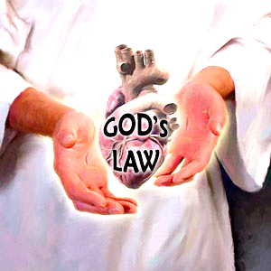
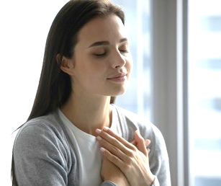
7. To be written in our hearts-
“This is the covenant I will establish
with the people of Israel after that
time, declares the Lord. I will put my
laws in their minds and write them
on their hearts. I will be their God,
and they will be my people.” (Hebrews 8:10)
Believing the Gospel is not enough.
God wants to write His laws into our hearts
and make us His people. How do we become
His people? By accepting God’s grace and
letting Him act in our lives.

Slide 21

Let’s imagine a husband and wife
who just got married. The wife is
very neat and orderly. She gets
upset when the husband leaves
his dirty clothes everywhere.
Instead of angrily commanding
him to pick up his dirty clothes and
wash them, the wife shows him
love and example by picking up the
dirty clothes, washing them, and keeping the whole house clean and organized every day.

Slide 22

As time goes by, the husband begins to value his wife’s cleanliness and appreciates her patience and love for him. Then he starts being neat at home also, washes his clothes and even those of his wife. He loves her wife more and more each day. The husband’s change of heart is not a result of demand and force, but of love. The fruit is a loving relationship between the husband and wife.

Slide 23
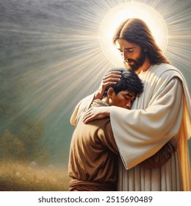
In the same way, because of our sinfulness, God had sacrificed His perfect Son. He gave us also the Holy Spirit to teach us how to live a holy life. He begins to change us from the inside out.
This results into a loving relationship with God. We show Him our love by obeying His 10 Commandments. He fills us with graces, and together with Mary, our Mother, and all angels and saints, we adore and glorify God.

Slide 24
Let’s all stand up and praise God’s Law
by reciting another part of Psalm 119.

Slide 25

Psalm 119: Praise of God’s Law
“⁹How can a young man keep his way pure?
By living according to Your word.
¹⁰I seek You with all my heart;
do not let me go away from Your commands.
¹¹Within my heart I treasure Your promise, that I may not sin against You.¹²Blessed are You, O Lord; teach me Your laws.
¹³With my lips I declare all the laws of Your mouth.
¹⁴I rejoice in the way of Your commands as much as in all riches.
¹⁵I will meditate on Your laws and consider Your ways. ¹⁶I will delight in Your orders; I will not forget Your word.”

